Slide 1
Operating Systems
Dr. Deepak Dembla

Slide 2
Basics of I/O Management

Slide 3
Objectives
Various types of devices
Need of device management
Layered structure for I/O software
Need of kernel I/O subsystem
How the kernel I/O subsystem provides device independence
Role of Buffering in device management
Types of Buffering: single buffering and double buffering
Role of Caching in device management
Life cycle of an I/O request

Slide 4
Types of I/O devices
I/O Devices
Character Oriented
Block Oriented

Slide 5
Techniques for I/O operation
Programmed I/O : processor ideally waits for an I/O
Interrupt Driven I/O : interrupt is generated by the device controller after an i/o operation so that the processor knows about the i/o completion.
DMA based I/O : Block interrupt is generated instead of generating multiple interrupts after every character.

Slide 6
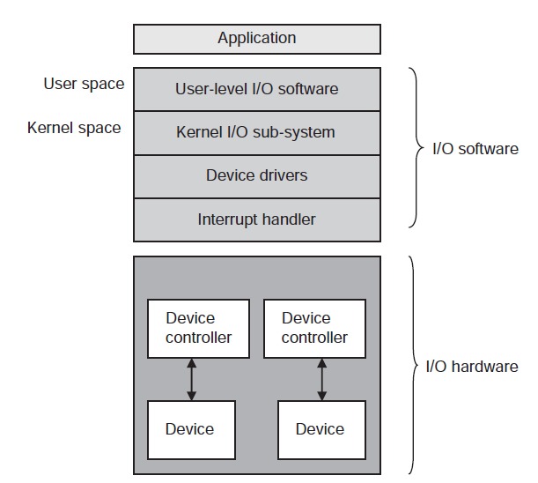
Layered structure for I/O software

Slide 7
Functions of a kernel I/O subsystem
Provides uniform interfacing to all the devices such that the user need not worry about the devices or their device drivers or their controllers.
Takes care of mapping the symbolic names of the devices to their actual hardware
Provides the access control to the I/O devices
Device scheduling
Increases the I/O performance of the system through buffering, caching, and spooling.
Notifies and handles errors properly so that the system runs properly despite of some error
Configures and initializes the device driver

Slide 8
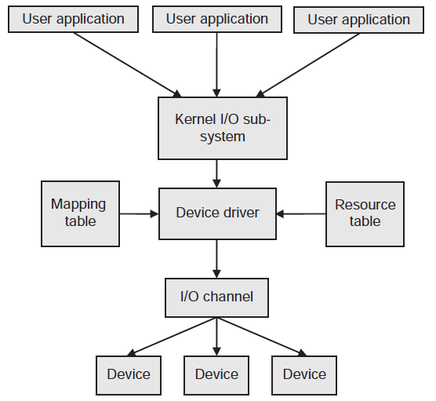
Device driver interface

Slide 9
Functions of a device driver
Accept the I/O requests from the kernel I/O subsystem
Checks the input parameters provided in the I/O requests
Translates logical address to the actual hardware details
Check the availability of a device and informs the same to its upper layer
An error code is returned if the device is not available.
Initializes the device to be interfaced
Control the I/O operation, i.e. prepare the sequence of commands, interfaces with the device controller and writes the sequence of commands to its registers one by one
Checks to see whether the device controller is able to accept the commands
Waits and blocks itself until an interrupt comes to unblock it.

Slide 10
Buffering
An I/O buffer is a memory area where data is stored temporarily during an I/O operation.
To cope up with the slow speed of devices in data transfer, a buffer is used known as single buffering.
When one full buffer is being copied to the user area, the data may be lost if it is coming continuously. In this case, another buffer is used to hold the data when the first buffer is emptied out. This is known as double buffering.

Slide 11
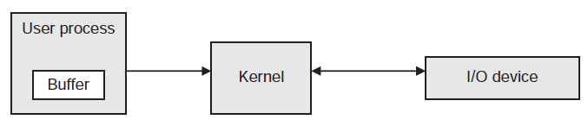
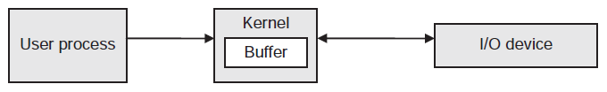
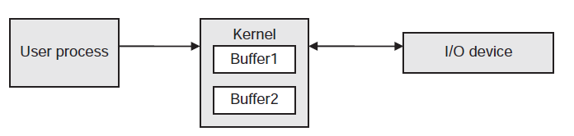
Types of buffering
Buffering in user space
Buffering in kernel space
Double buffering

Slide 12
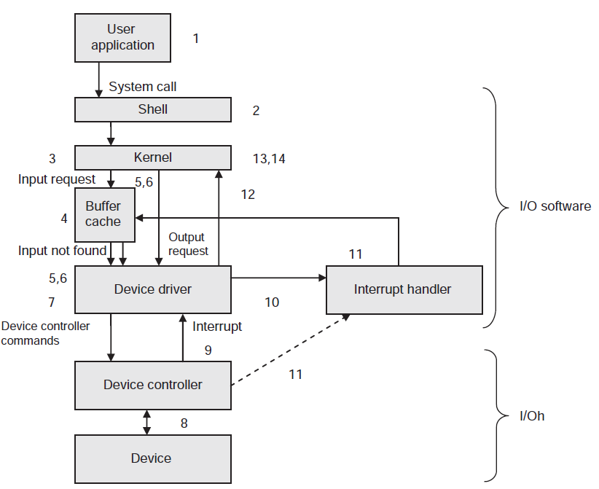
Life cycle of an I/O request

